Slide 1

Pharmaceutical Sales Course
This course prepares you for a successful career in pharmaceutical sales.
Learn essential skills, industry insights, and sales techniques to excel.

Slide 2

How to Be a Successful Pharmaceutical Salesperson
Build strong relationships
Understand products deeply
Connect genuinely with healthcare professionals and clients.
Know your portfolio to provide accurate and valuable information.
Listen and respond
Identify customer needs and tailor your approach effectively.

Slide 3

Training Course Objectives: Part 1
Industry Overview
Understand the pharmaceutical sales landscape and market dynamics.
Key Responsibilities
Learn vital roles and daily tasks of a pharmaceutical medical representative.
Skills & Characteristics
Develop traits to become an influential medical sales professional.
Golden Ps
Master the 10 essential principles of successful sales calls.

Slide 4

Training Course Objectives: Part 2
Prospection Techniques
Prospection Techniques
Prospection Techniques
Identify genuine client needs through strategic prospecting.
Identify genuine client needs through strategic prospecting.
Identify genuine client needs through strategic prospecting.
Handling Objections
Handling Objections
Handling Objections
Overcome daily market challenges and objections confidently.
Overcome daily market challenges and objections confidently.
DISC Assessment
DISC Assessment
Adapt communication to four doctor personality types using DISC.

Slide 5
Principles of Learning
Emphasize active learning, real-world application, and continuous feedback.
Integrate theory with practical scenarios for meaningful skill development.

Slide 6
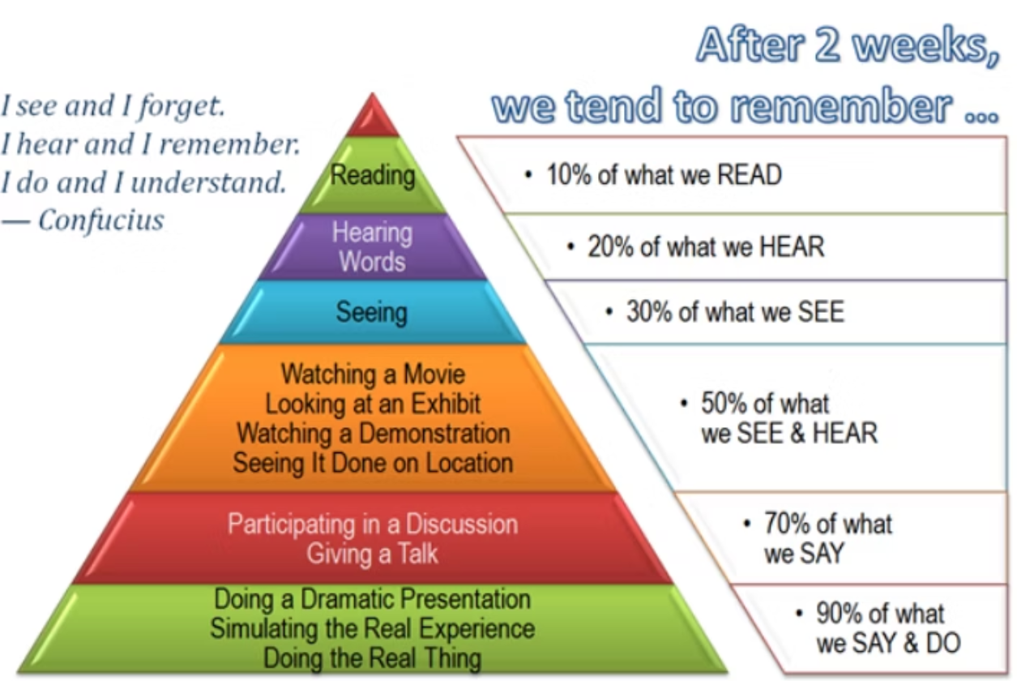

Slide 7

What is Pharmaceutical Sales?
Pharmaceutical sales is the process of identifying, generating, and influencing doctors' needs.
You then satisfy these needs with your product for mutual benefit.

Slide 8

The 5 Major Players in Pharmaceutical Sales
Successfully navigating these players ensures product acceptance and market success.
Includes patients, doctors, sales reps, companies, and regulatory bodies.

Slide 9
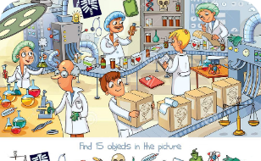




The Pharmaceutical Sales Puzzle Explained
Key Sales Factors
Patient Focus
Credibility & Relationship
Profit & Growth
Social Responsibility
Emphasize efficacy, safety, and cost-effective treatments.
Build trust and loyalty through knowledge and ethical conduct.
Drive customer loyalty and sustainable profit growth.
Profit & Market Share
New Markets
Market Dynamics
Leverage market expansion and innovation for competitive advantage.

Slide 10



Perceptions of Sales 20-30 Years Ago
Obtrusive
Parasitic
Sleazy and Non-Moral
Pushy
These outdated views highlight the need to evolve pharmaceutical sales approaches.

Slide 11
Modern Pharmaceutical Sales: The Shift
Old Sales
New Sales
Information imbalance
Information parity and asymmetry
Single call close
Multiple meetings—6 to 8 calls
Focus on product features
Focus on relationship and trust
Manipulation tactics
Educate and influence
Lower complexity
Complex problem solving
Success today depends on trust, listening, and strategic engagement.

